Slide 1
Oak Class
2026-27

Slide 2
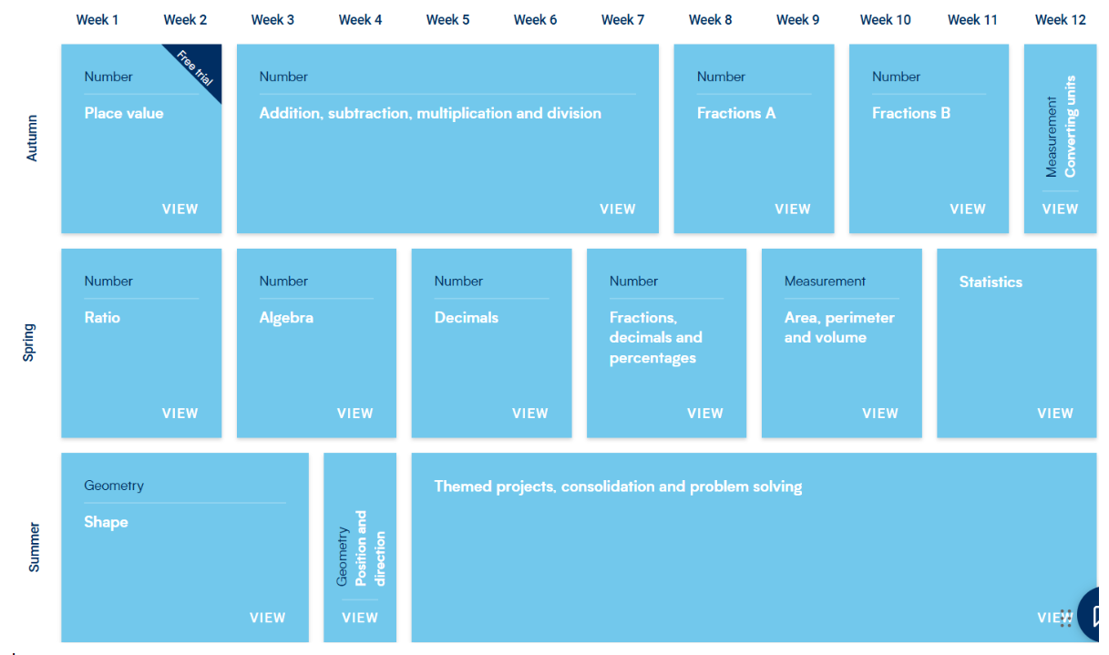
Core Subject - Maths

Slide 3
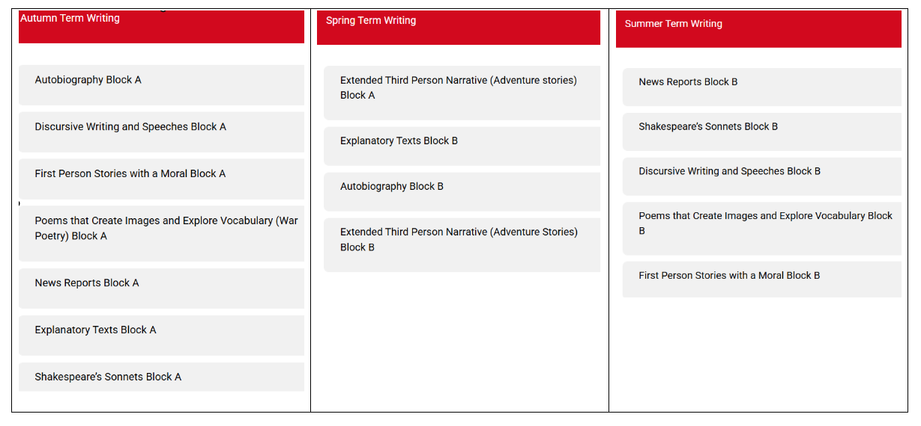
Core Subject – Writing

Slide 4
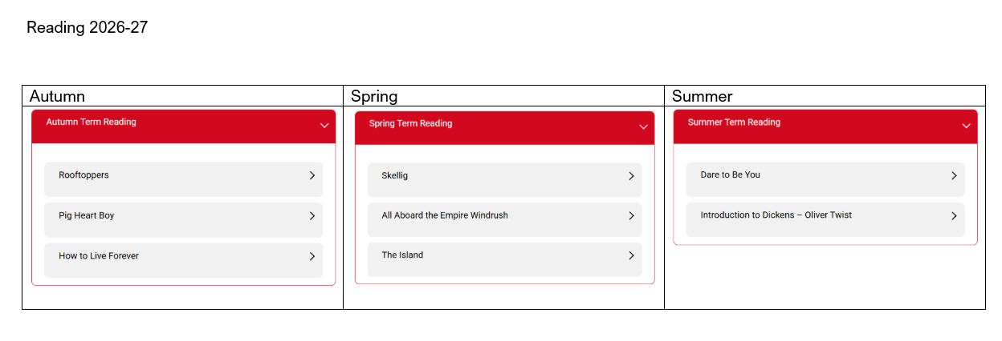
Core Subject - Reading

Slide 5
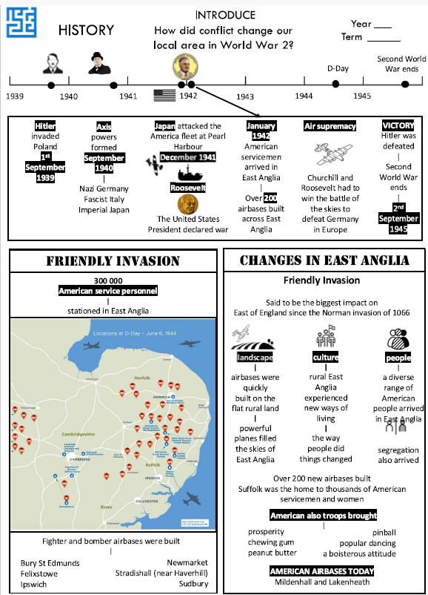
Foundation Subjects –
Autumn 1
How did conflict change our local area in World War 2?

Slide 6
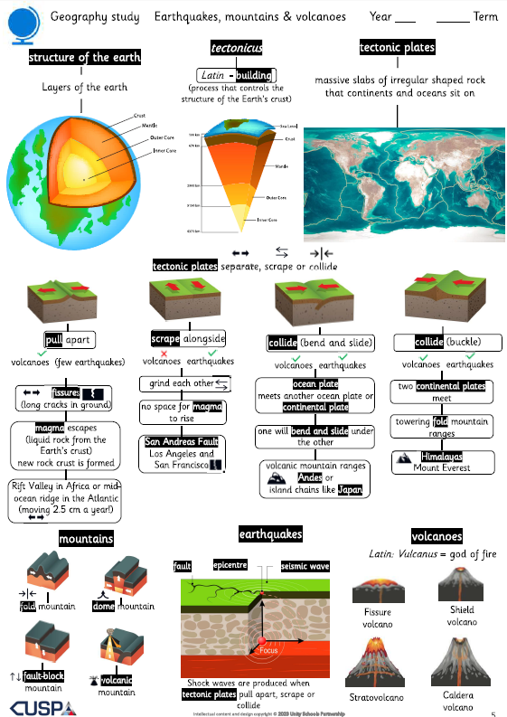
Foundation Subjects –
Autumn 1
Earthquakes, mountains and volcanoes

Slide 7
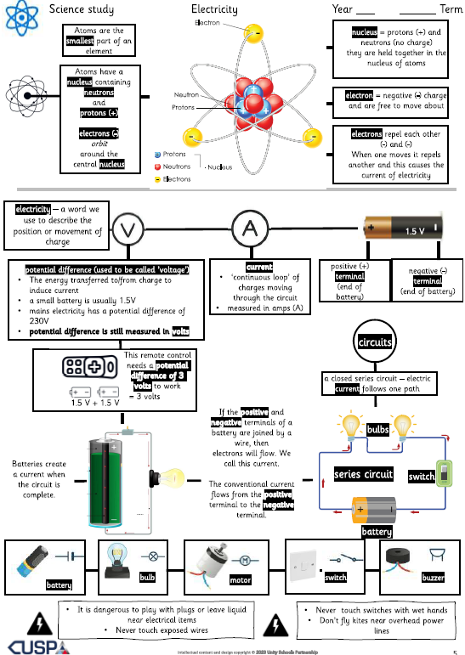
Foundation Subject -
Autumn 2
Electricity

Slide 8
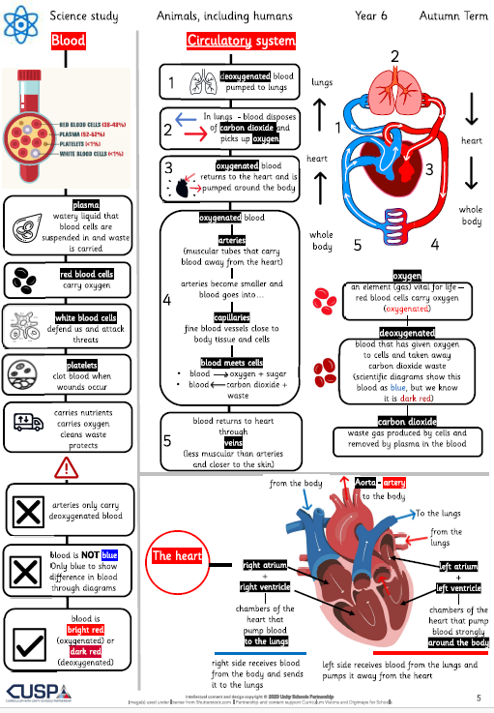
Foundation Subject -
Autumn 2
Animals, including humans

Slide 9
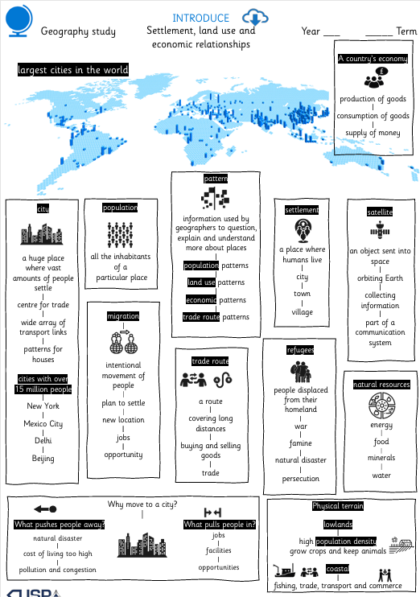
Foundation Subject -
Spring 1
Settlement, land use and economic relationships

Slide 10
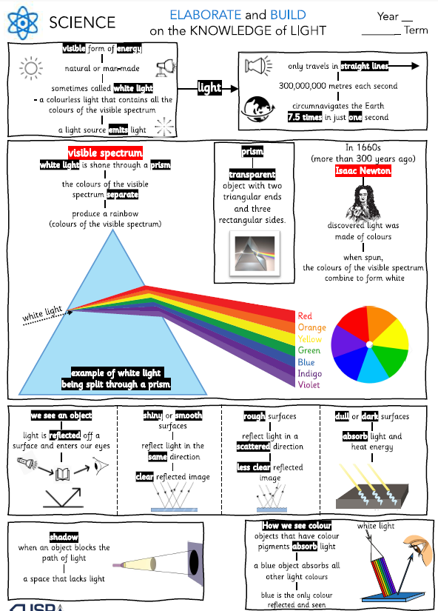
Foundation Subject -
Spring 1
Light

Slide 11
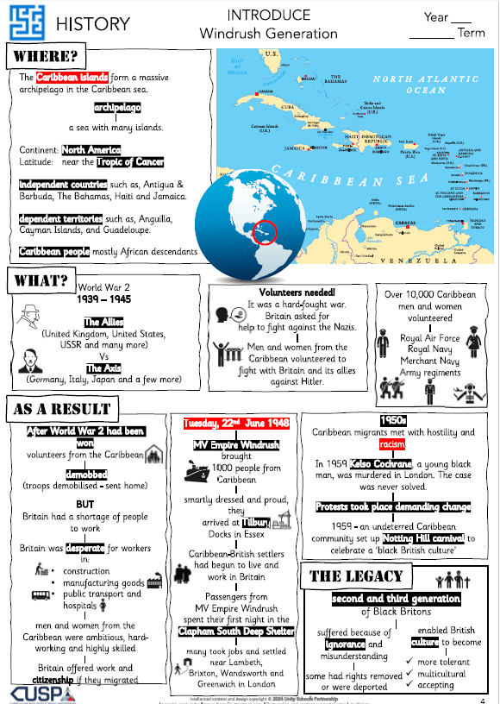
Foundation Subject -
Spring 2
Windrush Generation

Slide 12
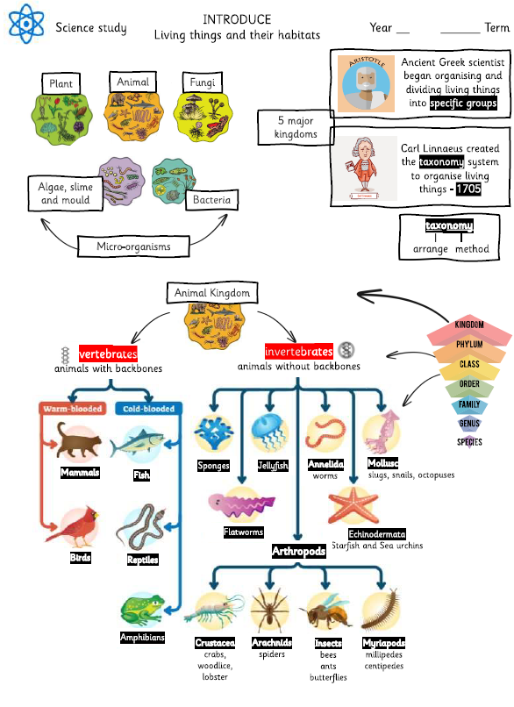
Foundation Subject -
Summer 1
Living things and their habitats

Slide 13
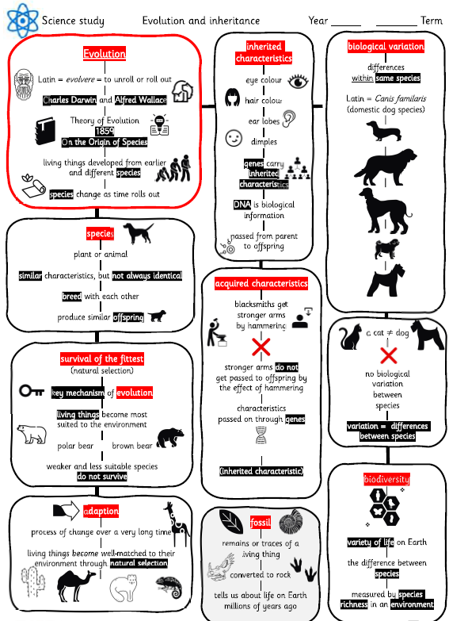
Foundation Subject -
Summer 1
Evolution and Inheritance

Slide 14
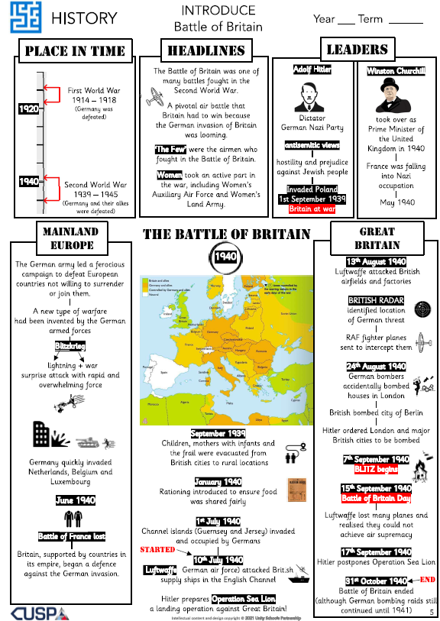
Foundation Subject -
Summer 2
Battle of Britain

Slide 15
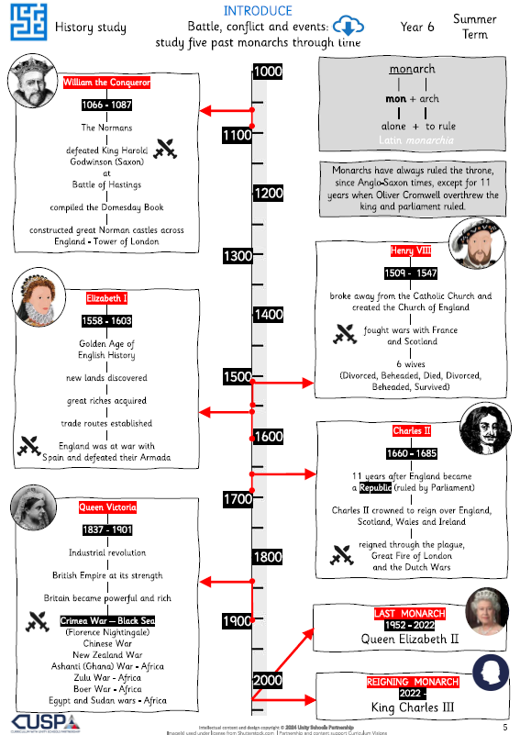
Foundation Subject -
Summer 2
Five Monarchs since 1066

